Slide 1

Week 8 APPLICATION EXERCISE Wind Farm Construction INTRODUCTION
GSOE9820 Engineering Project Management
Term 3 2021
Bernard Hayes

Slide 2

APPLICATION EXERCISE: Wind Farm Construction
Background:
You are the PM for ConstructCo, that is contracted to design & build a 99MW Windfarm for PowerCo.
Note – This Application Exercise is based on a real world scenario encountered during my career
1

Slide 3
Main Project Parameters:
Contract Price: $200M
Profit Margin = 10%
Schedule: 12 months
Damages for Delay: $5M per month – damages waived if delay kept under 2 weeks (ie a grace period)
(agreed to because Time is Critical to Customer)
Approved Cost Budget Contingency: $10M
1

Slide 4
APPLICATION EXERCISE: Wind Farm Construction
Current Status: The project is currently at the last day of Month 9.
As per the Attached Earned Value Analysis to end of Month 8, the Project has run smoothly, always ahead of schedule, under budget and forecast to remain so.
Accts Dept send you EV Analysis data for Month 9:
EV = $ 20M
AC = $ 21M
PV = $ 21M
1

Slide 5

EV Report to End of Month 8 – On Time / Under Budget
MONTH 8
MONTH | Aurhorised current budget (BAC) | Earned Value (EV) for Month | EV Cumumative | Actual Cost (AC) for month | Cummulative AC | Planned Value (PV) (assessed) for month | PV (assessed) Cumulative | SV | CV | CPI at end of month | SPI at end of Month | Estimated Cost to Complete (ETC) | Forecast costs at Completion (EAC) | Forecast Cost Variance at Complrtion
1 | $180,000,000 | $6,000,000 | $6,000,000 | $5,800,000 | $5,800,000 | $5,800,000 | $5,800,000 | $200,000 | $200,000 | 1.03 | 1.03 | $168,200,000 | $174,000,000 | $6,000,000
2 | $180,000,000 | $8,000,000 | $14,000,000 | $7,900,000 | $13,700,000 | $8,000,000 | $13,800,000 | $200,000 | $300,000 | 1.02 | 1.01 | $162,442,857 | $176,142,857 | $3,857,143
3 | $180,000,000 | $12,000,000 | $26,000,000 | $12,000,000 | $25,700,000 | $12,000,000 | $25,800,000 | $200,000 | $300,000 | 1.01 | 1.01 | $152,223,077 | $177,923,077 | $2,076,923
4 | $180,000,000 | $12,000,000 | $38,000,000 | $11,900,000 | $37,600,000 | $12,000,000 | $37,800,000 | $200,000 | $400,000 | 1.01 | 1.01 | $140,505,263 | $178,105,263 | $1,894,737
5 | $180,000,000 | $16,000,000 | $54,000,000 | $15,700,000 | $53,300,000 | $15,800,000 | $53,600,000 | $400,000 | $700,000 | 1.01 | 1.01 | $124,366,667 | $177,666,667 | $2,333,333
6 | $180,000,000 | $25,670,000 | $79,670,000 | $26,100,000 | $79,400,000 | $26,250,000 | $79,850,000 | -$180,000 | $270,000 | 1.00 | 1.00 | $99,989,984 | $179,389,984 | $610,016
7 | $180,000,000 | $39,350,000 | $119,020,000 | $38,950,000 | $118,350,000 | $39,000,000 | $118,850,000 | $170,000 | $670,000 | 1.01 | 1.00 | $60,636,725 | $178,986,725 | $1,013,275
8 | $180,000,000 | $35,750,000 | $154,770,000 | $34,250,000 | $152,600,000 | $33,000,000 | $151,850,000 | $2,920,000 | $2,170,000 | 1.01 | 1.02 | $24,876,255 | $177,476,255 | $2,523,745
9
10
11
Under Budget
1
On Time

Slide 6
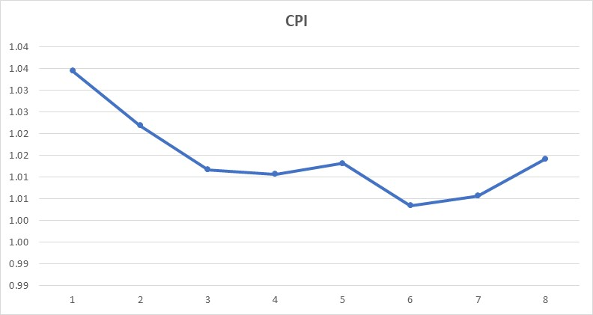
Main Project Parameters:
1

Slide 7
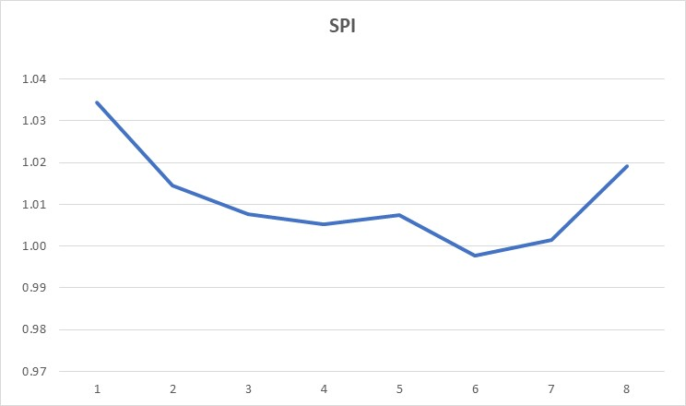
Main Project Parameters:
1

Slide 8

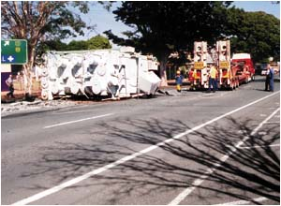
APPLICATION EXERCISE: Wind Farm Construction
As you start preparing what you believe is another favourable progress report for Month 9, the rings – BAD NEWS !!
Construction Accident – Transformer Damaged
Transformer on Critical Path
ConstructCo liable for all costs and delays
Delays -- $5 / month Delay Damages would be added to ConstructCo’s Costs (Grace Period for delays < 2 weeks)
1

Slide 9
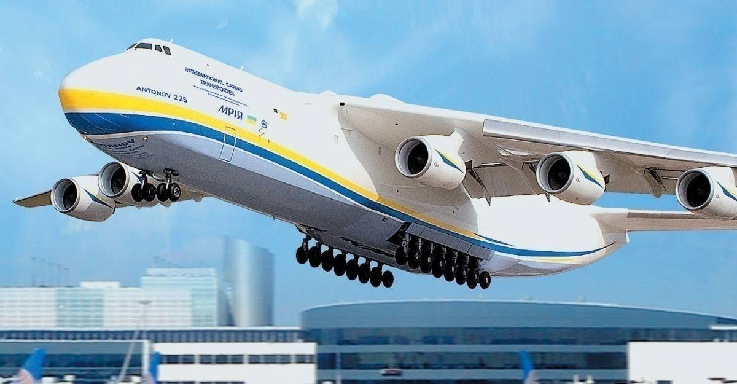
APPLICATION EXERCISE: What to Do?
Given time is critical to customer and damages for delay are significant, you decide you must implement a course of action today and include in this month’s progress report.
1

Slide 10
APPLICATION EXERCISE: Wind Farm Construction
You formulate and consider the following options:
1) Ship the transformer back to original Supplier for repair – Cost $2M; Schedule Delay: 6 Months
First Step complete Month 9 EV Analysis for each option, including any applicable costs for delay damages
2) Order replacement transformer from Original Supplier – Cost $4M: Schedule Delay: 4 Months
3) Order In-stock new transformer from Alternative Overseas Supplier and transport via Antonov Heavy Lift Air Transport: Cost $12M; Schedule Delay: 1 week (0.25 Months).
4) Repair Transformer at Local Workshop: Cost $5M; Schedule Delay: 1 Month

Slide 11
APPLICATION EXERCISE: Power Plant Upgrade
Question 1
Complete Earned Value Analysis for each option and indicate which option is likely to have a cost variance at completion within your allowable Project Contingency Budget.
Option (1)
Option (2)
Option (3)
Option (4)

Slide 12
APPLICATION EXERCISE: Power Plant Upgrade
Question 2
Looking at the CPI value you have calculated for Option (2) at end of Month 9, it indicates:
Option (2) would put the project over budget
Option (2) would put the project under budget
Option (2) would put the project over budget at completion
Option (2) would put the project ahead of schedule
1

Slide 13
APPLICATION EXERCISE: Power Plant Upgrade
Question 3
Looking at the SPI value you have calculated for Option (3) at end of Month 9, it indicates:
The project would be ahead of schedule
The project would be behind schedule
The project will finish ahead of schedule
Nothing accurate regarding the effects of option (3) on schedule. You would need to assess a Tracking Gantt chart to assess likely schedule impacts of Option (3)
1

Slide 14
APPLICATION EXERCISE: Power Plant Upgrade
Question 4
Looking at your EV analysis for each option, which of the following would you use to choose the optimum course of action for ConstructCo from the options:
The Option with highest CV
The Option with the highest SPI
The Option with the least negative Forecast Variance at Completion
The Option with the highest combined CPI + SPI
1

Slide 15
APPLICATION EXERCISE: Power Plant Upgrade
Question 5
ConstructCo’s CEO advises you that, following pressure from PowerCo management, ConstructCo needs to wiegh up maintaining its reputation for reliability with PowerCo (ongoing business valued at over $50M per year); against the financial result on a single project. Your CEO asks you to provide information on how much extra it will cost ConstructCo to execute the option with least delay over the optimum option for project outcome. You advise back:
-$11,154,088
-$ 9,094,238
-$ 2,059,850
-$31,752,589
1

Slide 16
APPLICATION EXERCISE: LOGISTICS
Tong Ju will now take you through the logistics of answering the AE, including:
How to access AE documentation
How your team can conduct discussions on the AE via MS Teams
How your team should submit your answers to the AE questions
Time allowed for AE
What will happen after AE finishes.
1

